Slide 1
SC1015 Mini Project
Flight Delay Prediction
Krishnan Akshar Dhruv (U2222448H)
Koh Heng Woon (U2221030C)
Mulani Mythili Janak (U2222678G)
Notes:
Welcome to Our SC1015 Mini Project on Flight Delay Prediction. Our Group Consists of myself, Akshar, and my teammates, Mythili and Heng Woon.

Slide 2
Table of contents
01
03
Introduction
Model and Analysis
02
04
Outcomes
Data Preparation
Dataset
Motivation
Machine Learning
Application of Model
Evaluation of Model
Conclusion
Insights
Data Cleaning
EDA
Notes:
Today I will take you through the following topics, Introduction, Data preparation, Model and Analysis and lastly the outcomes.

Slide 3
01
Introduction
Notes:
We will start by introducing our topic

Slide 4
Introduction
20+ Million flights taken yearly
Number of Delayed/Cancelled flights growing
Notes:
The Aircraft Industry is extremely important around the globe. Over 20 million flights are taken yearly, a large number of which move within the USA itself. Due to a variety of factors, the number of delayed and cancelled flights has been increasing since 2018.

Slide 5

How do various factors affect the status of a flight (On-time, Delayed, Cancelled)?
Notes:
Our Problem Statement: How do various factors, that we will discuss soon, affect the status of a flight. The 3 possible flighst status that our project will deal with are On-time, Delayed and cancelled.

Slide 6
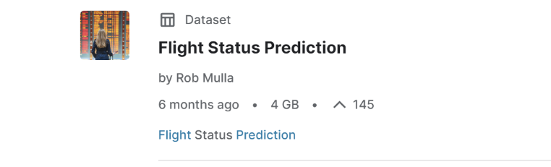
Dataset
Contains 2018-2022 data: Only 2018 and 2019 used
Only flights within USA
2018-2019: Pre-Covid (more indicative of current trends: 2023 onwards)
Notes:
For our Dataset, we have selected the Flight Status Prediction Dataset by Rob Mulla, available on Kaggle. It contains all the flight data regarding domestic flights involving the USA, and has data for the years 2018-2022. We have selected to only use the data for 2018 and 2019 as those are the pre-covid years, and are hence more indicative of the current trends as we are now moving to a time where covid has become controllable.

Slide 7
Motivation
Returning from times of peak covid: Increased air travel across the globe
Important to know flight status: Easy to plan ahead of time and adapt
Notes:
Our Motivation for choosing this topic is because we, as society, are returning from the times of peak covid. Though covid still exists and is prevalent, we are finding ways to live our original lives around it. Air Travel is one such aspect that has become extremely relevant again now that people are travelling more often and with fewer restrictions. Moreover, with our busy lives it is important that we predict or know our flight’s status ahead of time as it allows us to plan ahead and take decisions accordingly.

Slide 8
02
Data Preparation
Notes:
Now we will move on to the Data Preparation for our Model

Slide 9
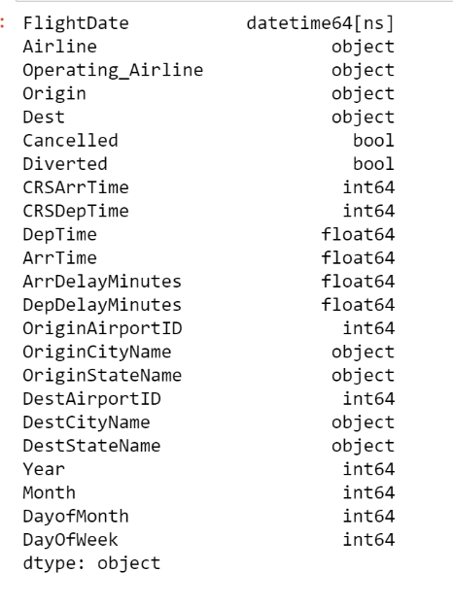
Data Cleaning
Notes:
We started by cleaning the data. The initial dataset had over 100 columns, but we only selected the relevant 23 ones, that can be seen in the picture. Moreover, we cleaned the data to remove all flights from 2020-2022 as we chose not to consider flights from that year.

Slide 10
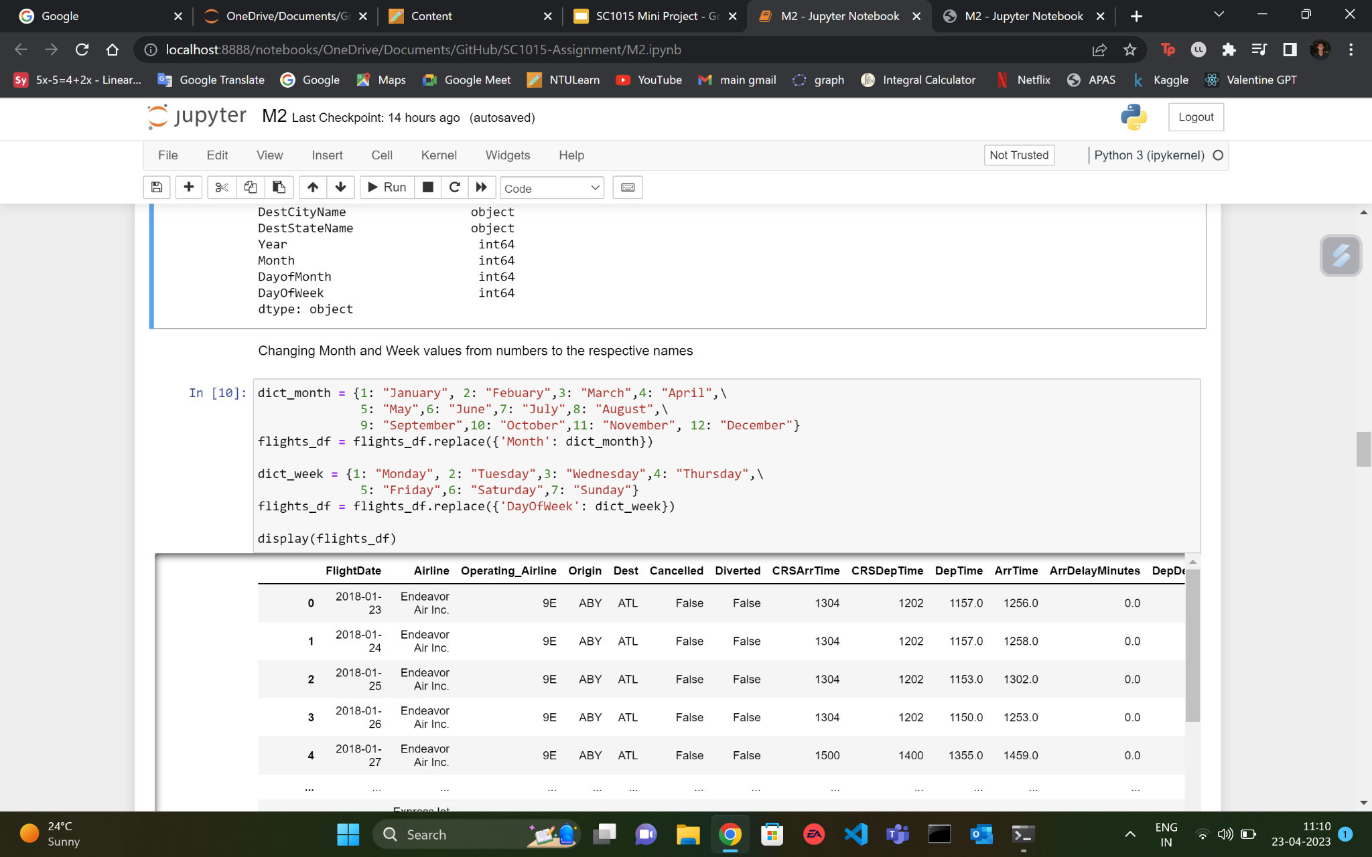
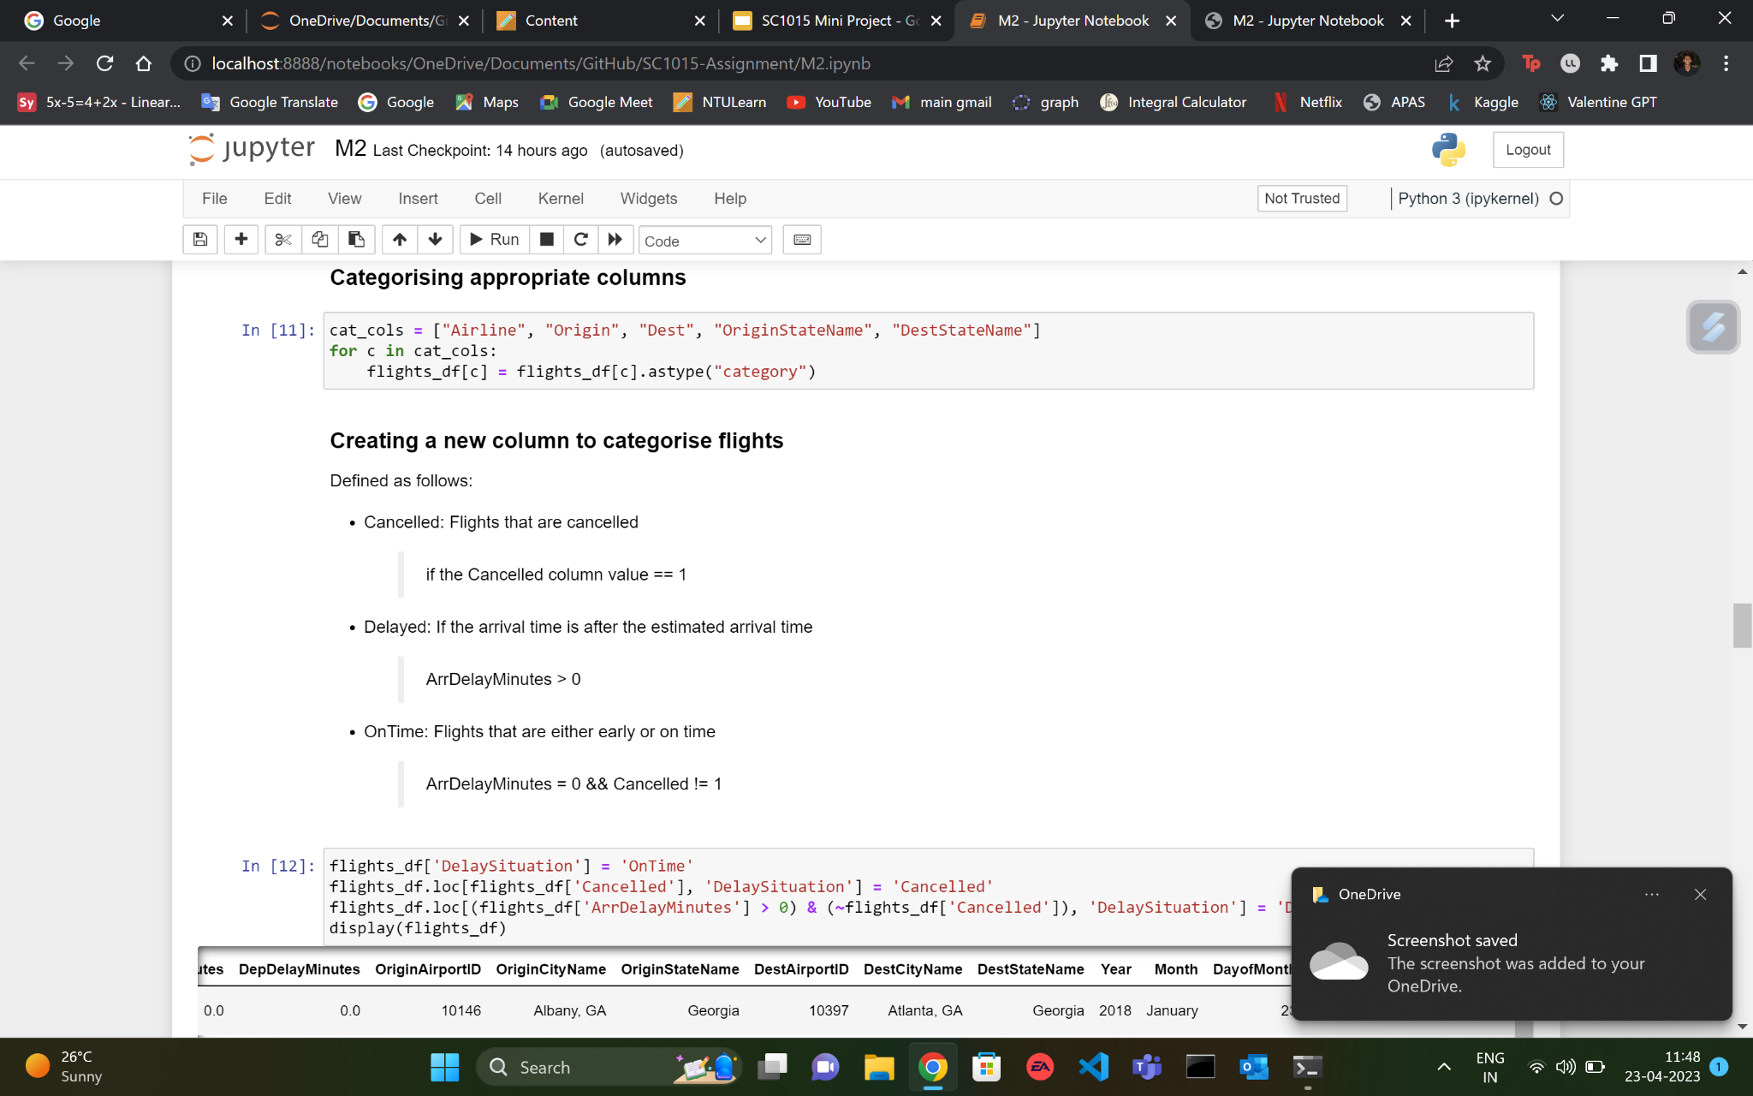
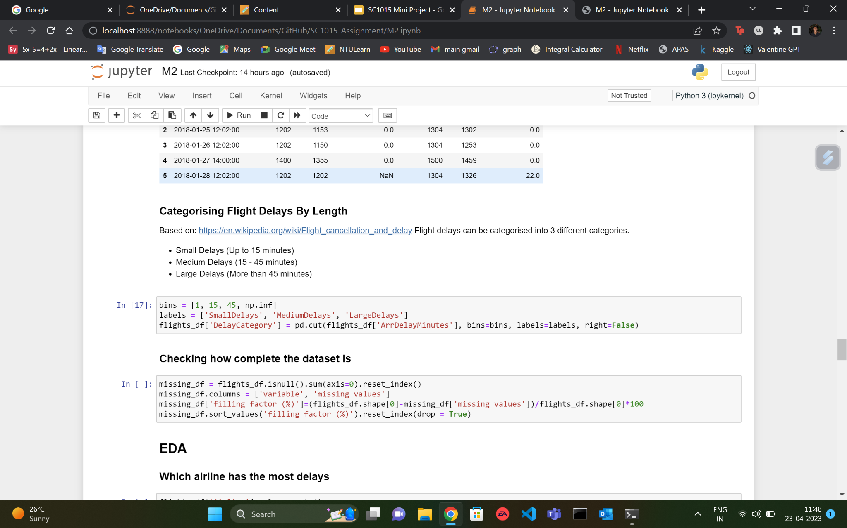
Modifications
Changing Month and Day from
Numerical => Name
Adding Variables: DelaySituation, DelayCategory
DelaySituation
DelayCategory
Notes:
We also made some modifications to the data frame. We noticed that the day and month that were given the data frame were numerical. However, we believed it would be easier if we used the actual names of the days and months, and hence we changed those variables from numerical to their names (Categorical). We also added two of our own variables, the first being DelaySituation which is a categorical variable that indicates whether a flight is Cancelled, Delayed or On-Time, and DelayCategory, which denotes the range of delay duration for a flight,

Slide 11
Exploratory Data Analysis (EDA)
Notes:
Now, onto the Exploratory data analysis.

Slide 12




Flight Status
Flight Company
Month of the Year
Day of the Week
Destination City
Notes:
We want to predict the flight status based on a variety of factors. For our model, we have selected the following 4 factors to test- Flight company, month of the year, day of the week and lastly, destination city. We will carry our bivariate statistical analysis for all these variables, and see if we can identify any trends that indicate flight status from these variables.

Slide 13
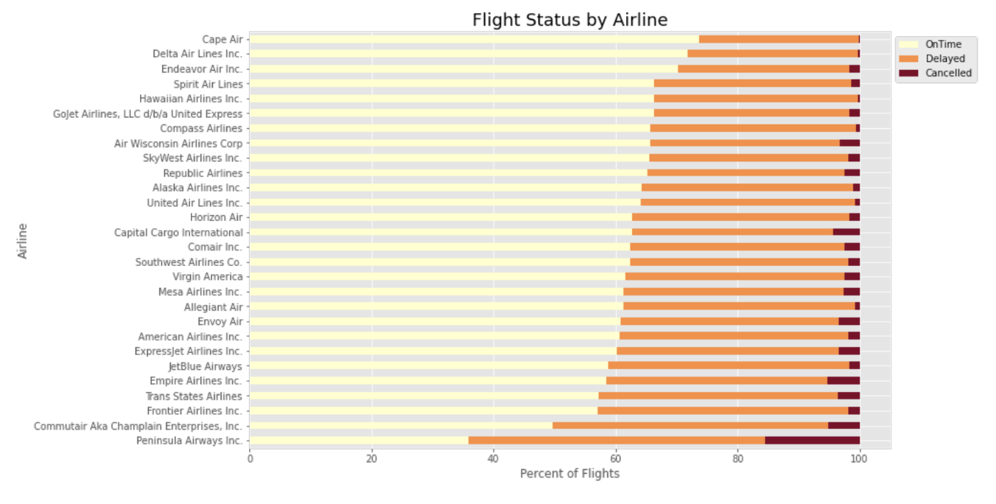
Flight Company
WHY?
Area of Operation
Fleet Size
Operational Issues
Notes:
For our first factor, we used a horizontal bar plot to show the percentage of flights that are on time, delayed and cancelled for each of the airline companies operating in the USA. Our group chose to go beyond correlation, and also find out possible causation for each factor and its effect on flight status. For Flight Company we identified Area of operation, Fleet size and Operational issues that affect how a flight company affects flight status. Companies that operate in areas like Alaska are more likely to have higher percentages of delayed and cancelled flights. SImilarly, companies with fewer aircrafts are also more likely to face similar issues due to lack of flexibility and backups. Lastly, operational issues like understaffing and system failures can also affect a flight company’s percentage of on time flights.

Slide 14
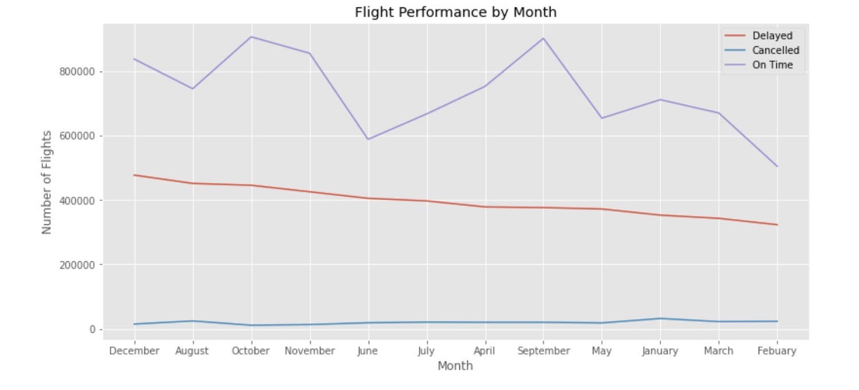
2. Month of the Year
Delayed:
December > August
Cancelled:
January > August
Notes:
Next we will move on to the Month of the Year. We created the following plot, that gives the number of flights in each category that occur every month. The months are arranged in decreasing order of delayed flights. We can see that For delayed, december and august have the highest, while for cancelled, january and august have the highest.

Slide 15
Reason
Delayed
Cancelled
January: Harsh Weather Conditions- Snowstorms, Blizzards
August:
Natural Disasters- Hurricanes, Thunderstorms
December: Holiday Season, Mild to extreme winter conditions
August: Summer Holiday Season, Crew scheduling difficulties
Notes:
We believe that the flights are delayed and cancelled more in different months for various reasons. December and August are peak holiday seasons leading to overcrowding of airports and congestion leading to more number of delayed flights. We believe that for cancelled flights the reason that certain months have higher number of them is because of extremely harsh weather conditions that arise during the months of January and August. In the USA, January is the month with the most snowstorms and Blizzards with atleast 5 severe ones occurring every year in this month. August is prone to thunderstorms and Hurricanes that ravage coastal areas forcing airports to shut and flights to be cancelled.

Slide 16
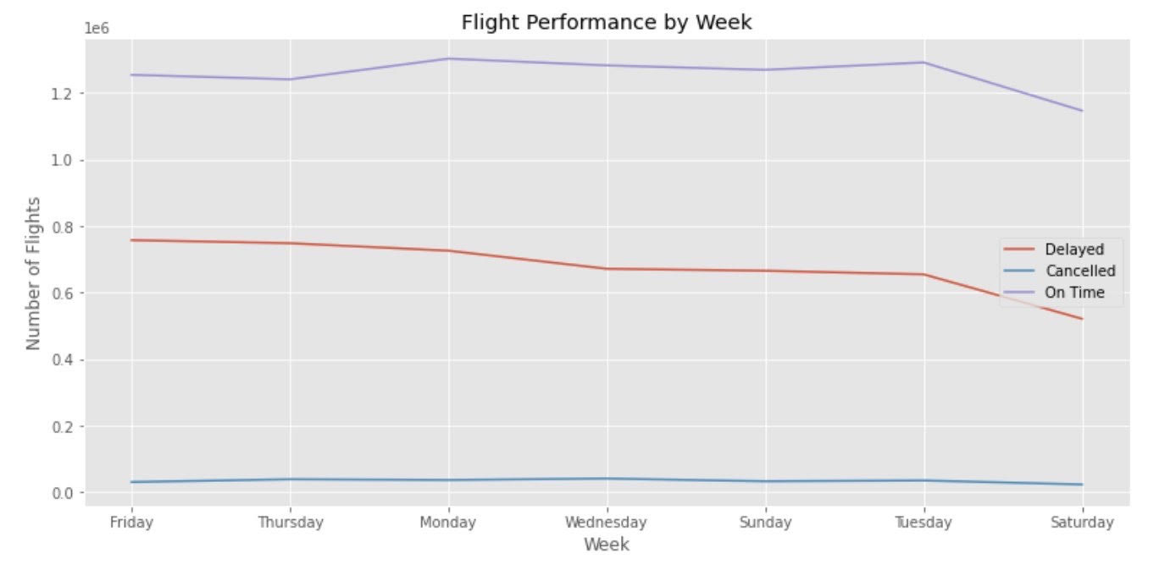
3. Day of the Week
Delayed:
Friday > Thursday > Monday
Cancelled:
No Trend
Notes:
Like our second factor, we have plotted the Day of the week with number of flights in each category on a Line graph. We can see that Friday Thursday and monday have the highest number of delayed while the number of cancelled flights is roughly the same for all days.

Slide 17
Reason:
Varying levels of Airport Congestion on various Days
Notes:
The reason that the day of the week may affect flight status is because of varying levels of airport congestion on different days. More the congestion, higher the likelihood of a delayed flight. This reason will not cause flights to be cancelled and hence there is no clear correlation there. For days like Friday and monday, these are peak travelling days for families going on vacations. Thursday is an important day for business travel as businessmen generally prefer to maximise their time spent at their destination.

Slide 18
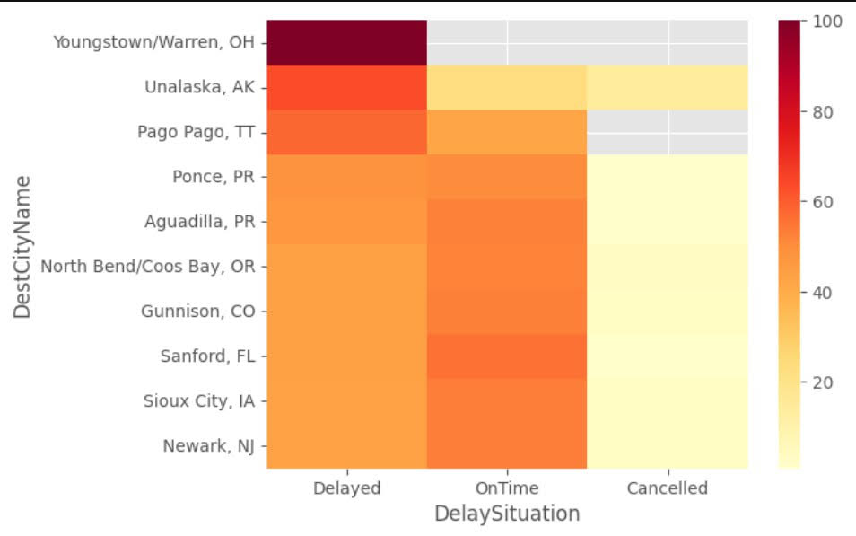
4. Destination City
Notes:
Lastly for destination city, we plotted a heatmap with the destination cities with the highest percentage of delayed flights.

Slide 19
03
Model and Analysis
Notes:
Now we will discuss the Model we have used to test our data

Slide 20
Model Used
Baseline ML models that support Multiclass Labelling
DecisionTreeClassifier
BaggingClassifier
BernoulliNB
RandomForestClassifier
Notes:
We chose some baseline Machine Learning Models that support Multiclass labelling like DecisionTreeClassifier, BernoulliNB, BaggingClassifier, RandomForestClassifier and ExtraTreeClassifier.

Slide 21
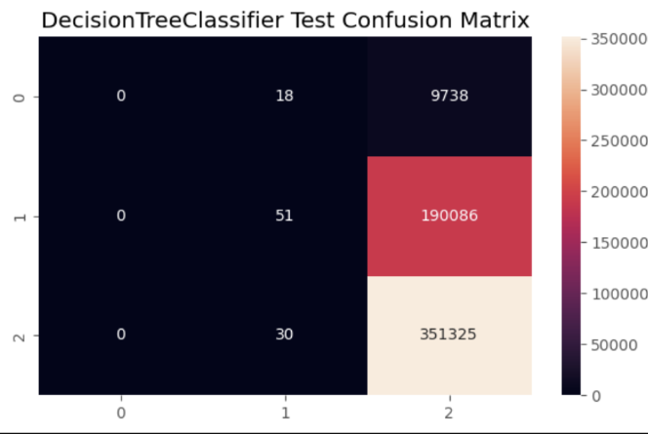
Round 1
Only 1 feature: Airline company
HIGH BIAS!
Notes:
For our first round of testing, we chose to use only Airline company as a variable. We tested it out using all 5 of the aforementioned models, and all the heatmaps for the test data look similar to this- with high bias for the 2nd category.

Slide 22
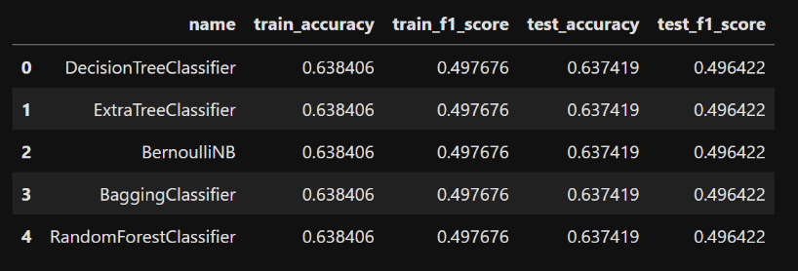
Round 1
Only 1 feature: Airline company
ACCURACY: QUITE LOW
Can We Improve?
Notes:
The accuracy for our first round is quite low with the f1 test scores being 0.496. Moreover there was extremely high bias from the heatmaps. So, we wondered whether we could improve our model in any way, and carried out 2 more attempts to do so.

Slide 23
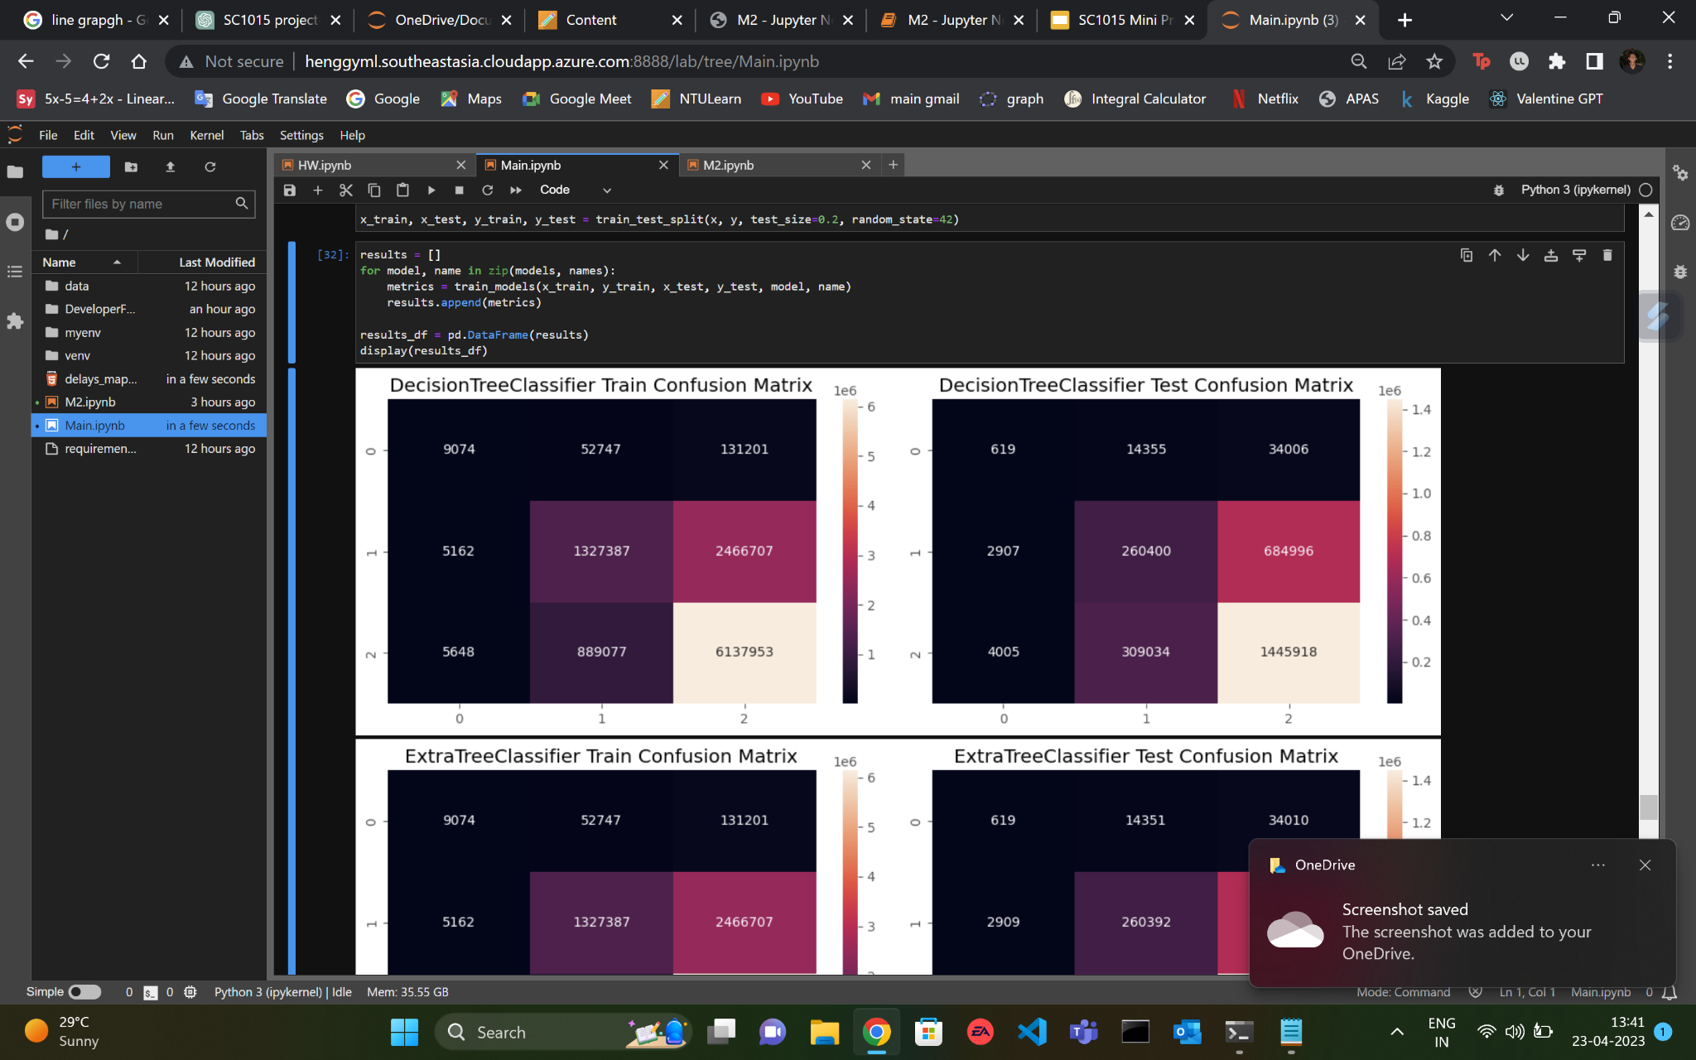
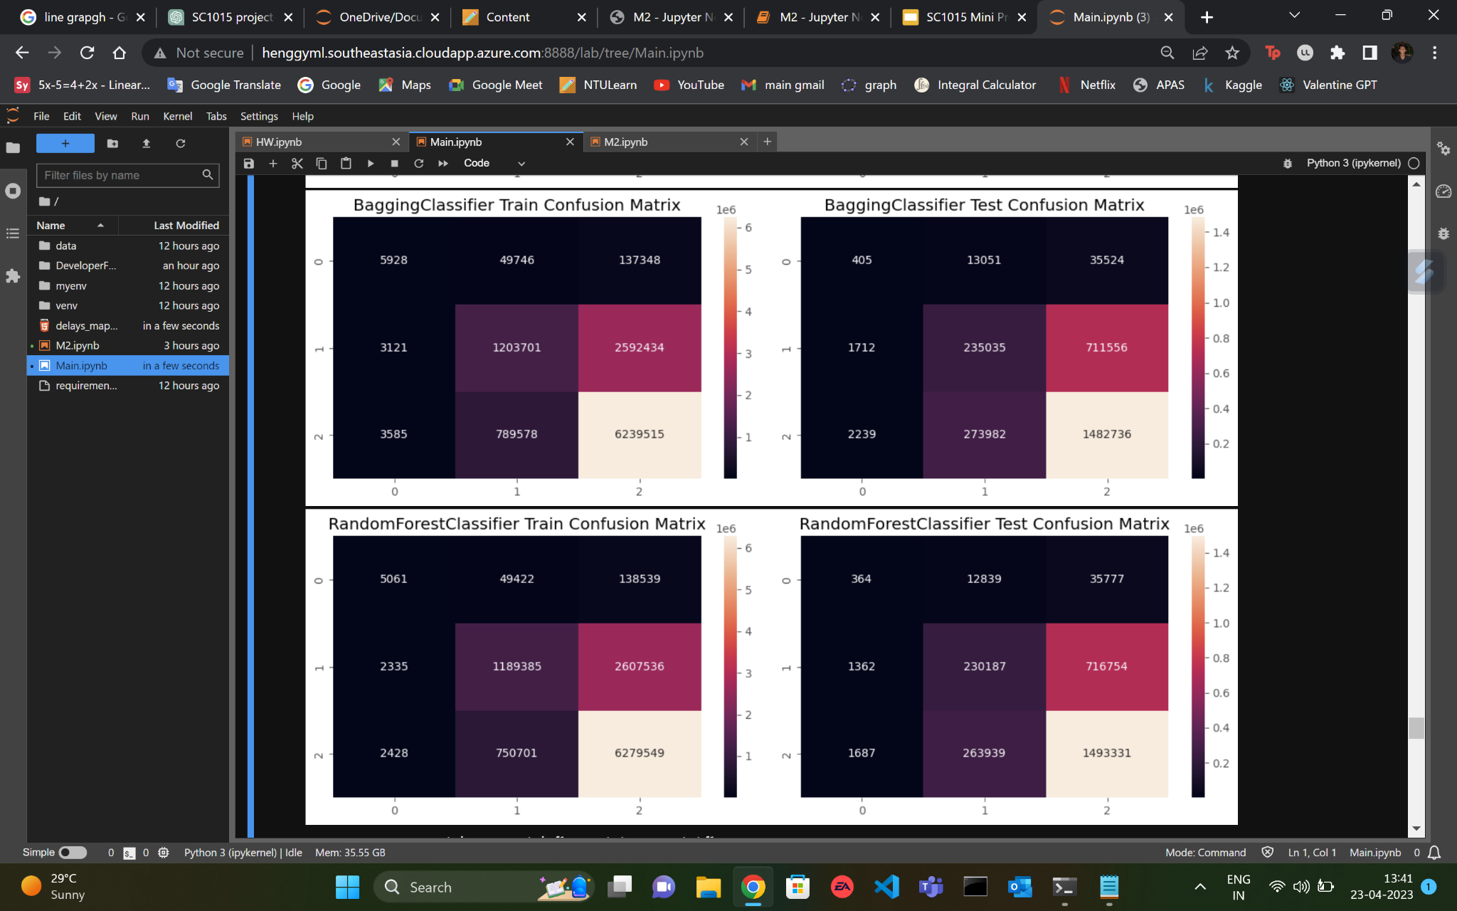
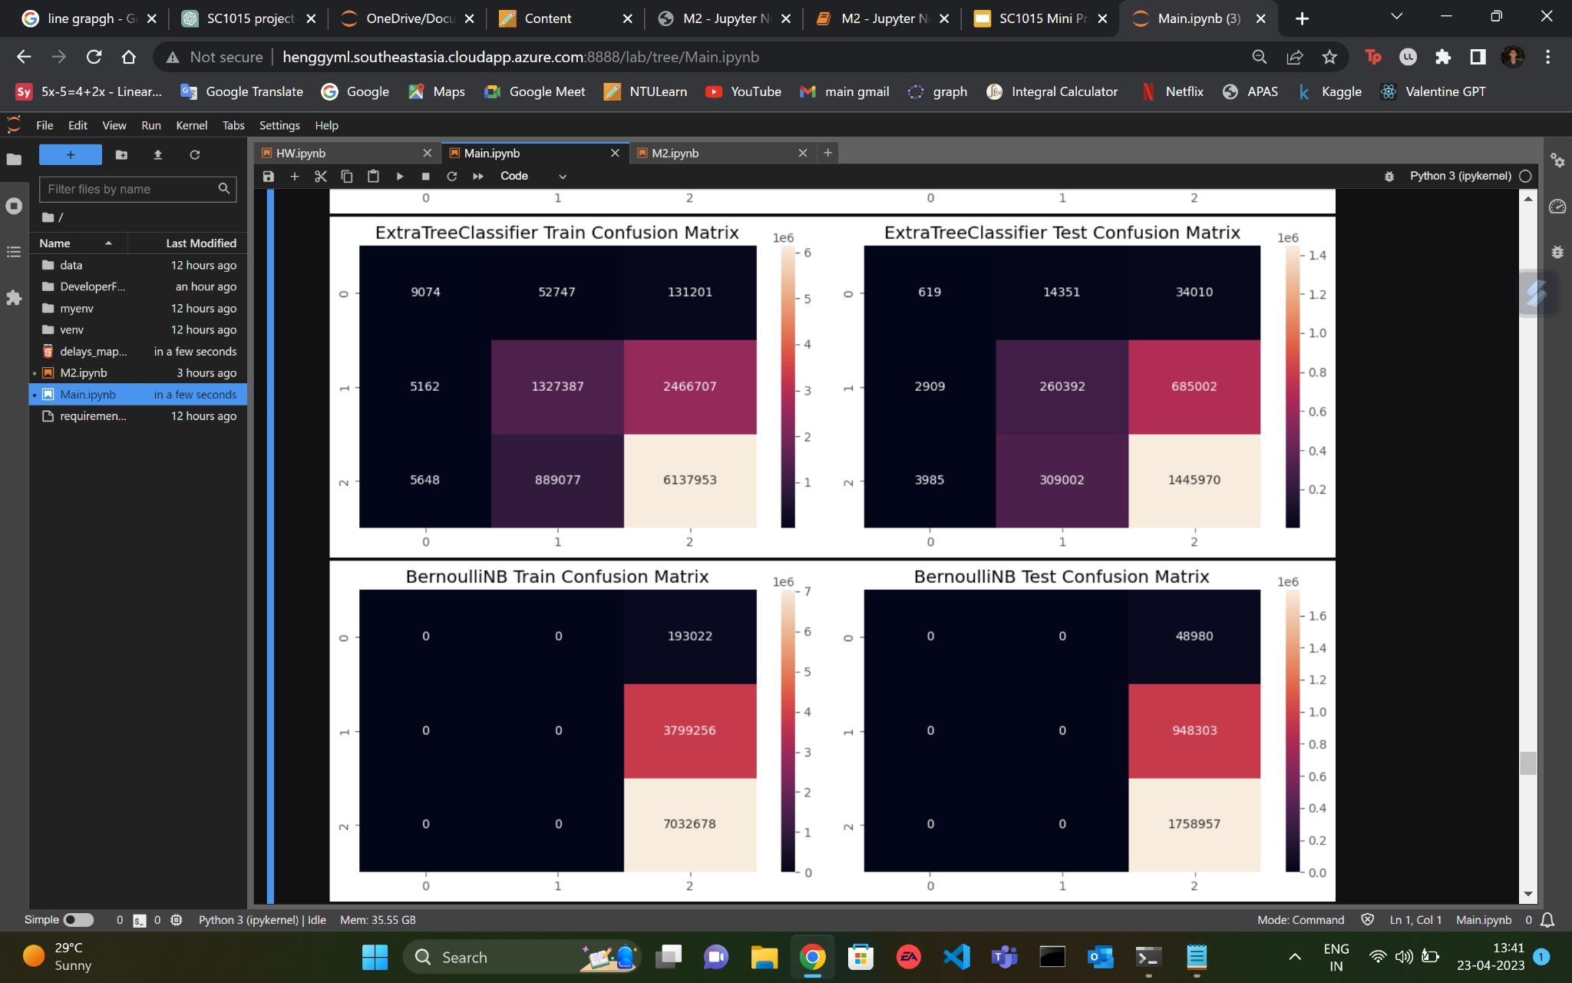
Round 2
New features added: Airline company, Origin, Destination, Month, DayOfWeek
Notes:
For our second round we added more features to the model including Origin and Destination city, Month and Day of the Week. Now for these models, the confusion matrices are no longer highly biased, except Bernoulli, which displays the same bias as in round 1.

Slide 24
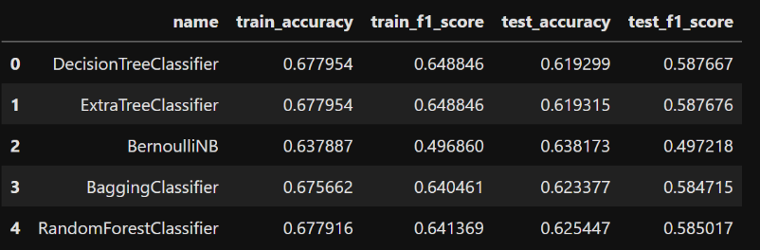
Round 2
Multiple features
ACCURACY: Better, but still low
Can We Improve Again?
Notes:
It can be clearly seen that the accuracy of the second round has improved since the first with the f1 test scores, which is the measure of accuracy, has improved for all 5 models: From 0.496 to roughly 0.58-0.59 for the other models. It can be observed that BernoulliNB model has the same test f1 score, and will hence be dropped due to its high bias. It can also be seen that out of the DecisionTreeClassifier and ExtraTreeClassifier models, which are extremely similar models, the DecisionTreeClassifier has a slightly higher score and hence we will use that and drop the other. We will also keep the Bagging and Random Forest models as they have test scores comparable to DecisionTreeClassifier.

Slide 25
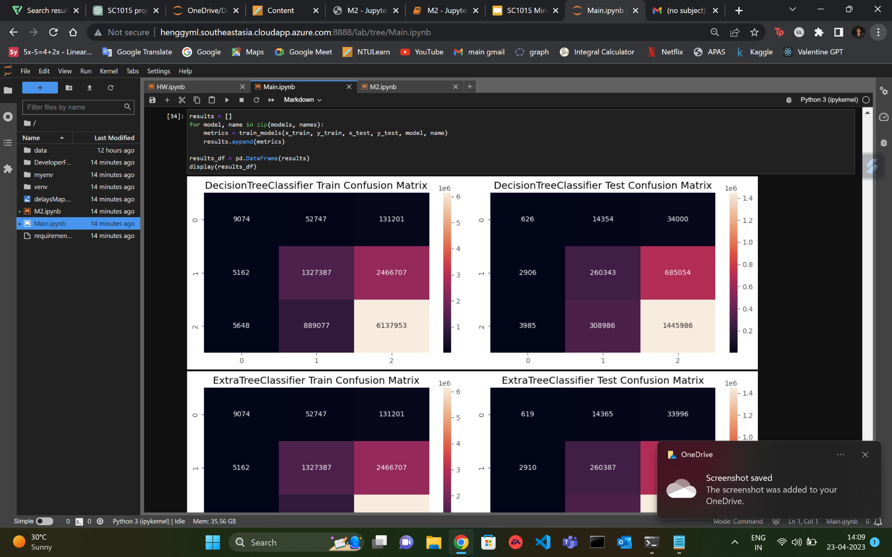
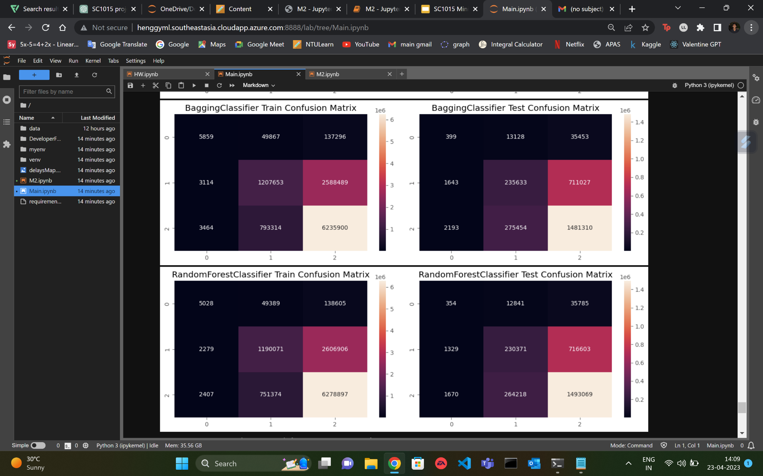
Round 3
Polynomial Features added
Only 3 models selected
Notes:
Now for our final round of testing, we decided to add some polynomial features to the 3 models that we have selected. Their confusion matrices can be seen here, with similar values and trends as the second round.

Slide 26
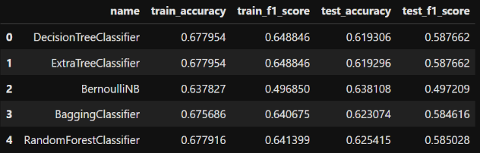
Round 3
Polynomial Features added
ACCURACY: Similar to Round 2
Notes:
Here we will only look at the test f1 scores for the 3 models we selected. It can be seen that the accuracy scores for the 3 models are more or less the same as round 2. The values remain in the 0.584-0.587 range for all 3 models, indicating that adding polynomial features did not make much of a difference to our testing model.

Slide 27
04
Outcomes
Notes:
Now we will conclude our presentation.

Slide 28

Conclusion
Final accuracy still low
Polynomial Features: No effect
More Features => More accurate
Notes:
From our 3 rounds of testing, we saw that on adding more relevant features, the accuracy of the model improved. However it is also clear that the final accuracy is still low, with it barely touching 0.6, which suggests that it is not easy to predict whether a flight will be delayed or cancelled by only using a handful of factors. Lastly we concluded that polynomial features had no effect on our model, as it is more applicable for regression models, than Tree based models.

Slide 29
Insights
Still need to improve accuracy: trying newer models
To further improve: Try to take more features into consideration that were unavailable in this dataset like Flight duration and number of passengers on flight
Further: Predicting delay time
Notes:
To further improve our project, we could have used newer models to improve the testing accuracy. We could have also tried to add new features from other data sets such as flight duration and number of on board passengers. If this was achieved, we could have further improved our project by also designing a model to predict the delay time of a flight.

Slide 30
Thank You!
Notes:
That brings us to the end of our presentation. Thank you for your time and attention

